Slide 1

World University Rankings Analysis

Slide 2
Introduction
The academic landscape is greatly influenced by world university rankings, which also shape how educational institutions are viewed around the world. Our study focuses on factors influencing the rankings to provide insights into the dynamics that either elevate universities or cause them to fall in the eyes of the world.
Through the identification of influential individuals, our goal is to equip universities with strategies to effectively navigate the highly competitive world of higher education and achieve favorable rankings worldwide.
Study Overview: Exploring key factors influencing the World University rankings.
Data: World University Rankings 2023 and GDPPrayer
Focus: Location, gender, international student ratio, etc.
Five statistical methods: Linear Regression, Decision Tree Regression, Principal Component Analysis (PCA) for dimensionality reduction, K-Means Clustering, and Hypothesis Testing using ANOVA and the Chi-Square Test

Slide 3
Literature Review
1. Funding, is it key for standing out in the university rankings?
Benito et al. (2019) conducted a quantitative evaluation investigating the influence of funding on university rankings. It offers useful information for universities looking to strategically improve their academic standing being crucial for our research.
2. The task of improving the University Ranking based on the Statistical Analysis Methods.
Mikryukov et al. (1970) examined the relationship between university performance indicators and ranking functionality using correlation regression and factor analysis techniques. By implementing their report's suggestions, we can customize our own approaches to enhance university performance metrics.
3. Characteristics of highly ranked universities in the Times Higher Education (the) World University Rankings.
Sharif et al. (2015) used quantitative methods to analyze factors influencing Times Higher Education (THE) rankings. We took advantage of a comparable quantitative framework, which expands the range and practicality of our own analysis of university rankings.
For this research project, we incorporated the research findings from the referenced studies into finding any trends that explain our research objectives.
We aimed to go beyond simple numerical measurements to understand the practical consequences of university rankings for academic institutions as well as students.
3
Notes:
Apurva

Slide 4
Research Questions
Q1. To what extent do teaching, research, and citation scores contribute to predicting and understanding the university's overall Score' in rankings? Method – Linear Regression Analysis
Q2. How do universities group based on teaching, research, and international outlook scores, and what insights do these clusters reveal about shared characteristics? Method – K-means Clustering
Q5. Is there a significant association between university ranking categorical variables and university types? Method – Chi-Squared Test
Q3. What are the key factors contributing significantly to the variability in University Rankings? Method - Principal Component Analysis
Q4. Does the exploration of complex, non-linear relationships and interactions among influencing factors contribute to understanding University Rankings?
Method - Decision Tree Regression

Slide 5
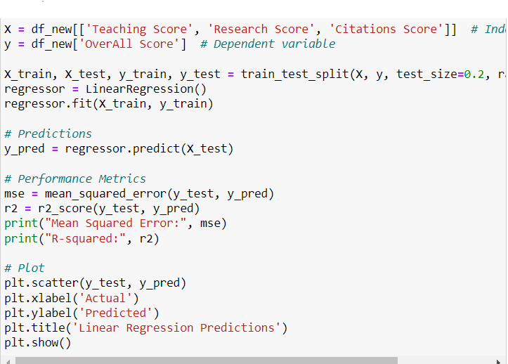
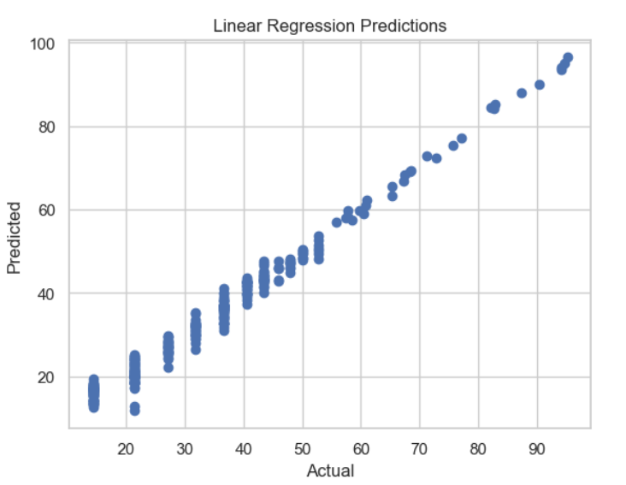
To what extent do teaching, research, and citation scores contribute to predicting and understanding the university's overall Score' in rankings? Linear Regression Analysis
Methodology:
Brief Description: Linear Regression is a statistical method used to model the relationship between a dependent variable and one or more independent variables by fitting a linear equation.
Process: We divided our dataset into a training set and a testing set. The model was trained on the training set to establish a relationship between the predictors and the university ranking. We then used the testing set to evaluate the model's performance.
5

Slide 6
Conclusion:
A low model mean square error (MSE) indicates that the link between the factors and the final university score were accurately represented. This model's MSE is 8.190, which indicates a more accurate scope as it is closer to 1. Much of the variability in the dependent variable is captured by the model's R-squared value of 0.961.
Mean Squared Error: 8.190777404921699 R-squared: 0.9610115844744507
To what extent do teaching, research, and citation scores contribute to predicting and understanding the university's overall Score' in rankings? Linear Regression Analysis
Application:
In this project, we used linear regression to predict the universities' 'Overall Score.' The independent variables 'Teaching Score,' 'Research Score,' and 'Citations Score' influenced the dependent variable, the universities' 'Overall Score.'
6

Slide 7
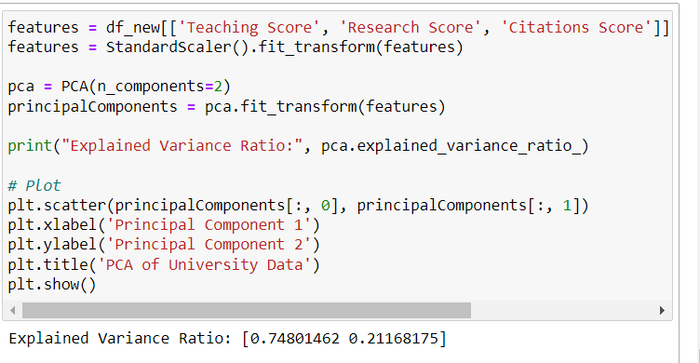
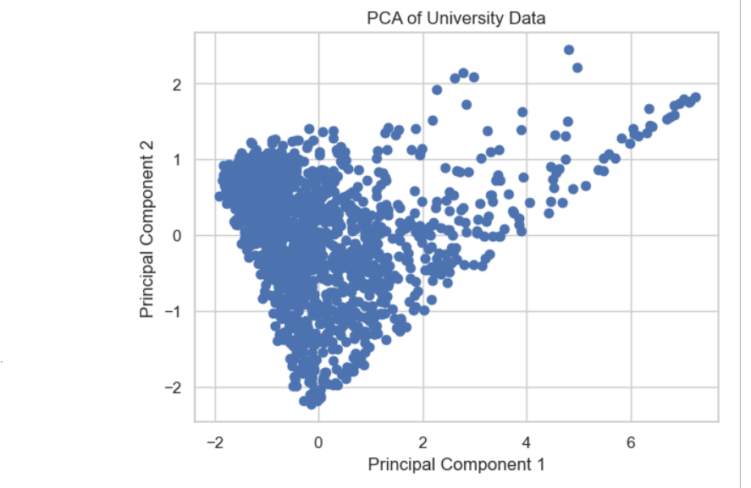
What are the key factors contributing significantly to the variability in University rankings? Principal Component Analysis
Methodology:
Brief Description: Principal Component Analysis is a dimensionality reduction technique that transforms a large set of variables into a smaller one that still contains most of the information in the large set. It does this by identifying directions, called principal components, along which the variation in the data is maximized.
Process: The variables 'Teaching Score', 'Research Score', 'Citations Score', and 'International Outlook Score' were standardized. PCA was then applied to reduce the dimensionality of the data, and the principal components explaining the most variance were analyzed.

Slide 8
What are the key factors contributing significantly to the variability in University rankings? Principal Component Analysis
Conclusion:
The dataset was reduced to two principal components using this method, which accounts for almost 96% of the variance. The second component, on the other hand, captures a significant amount of the variance, matching more closely with worldwide orientation, highlighting elements other than academic results that shape a university's global reputation.
Application:
Principal Component Analysis (PCA) was used in this study to distill complex university ranking data into principal components that capture the essence of what factors contribute most significantly to the variability in university ranking.
8

Slide 9
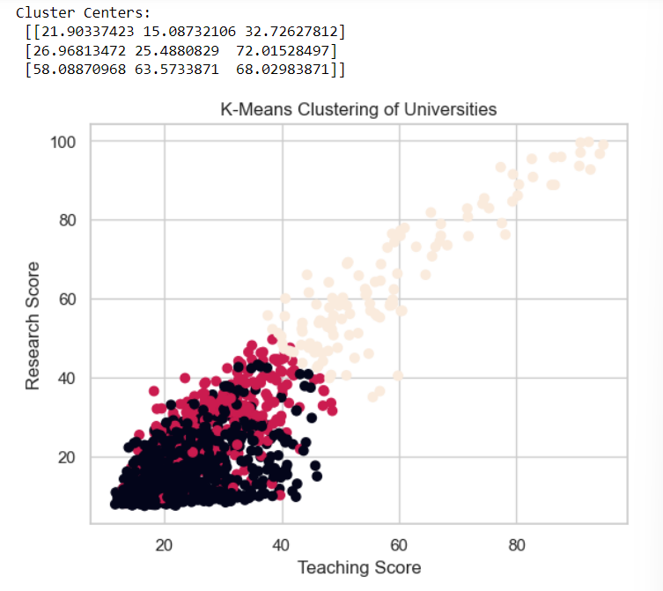
How do universities group based on teaching, research, and international outlook scores, and what insights do these clusters reveal about shared characteristics?
K- Means Cluster Analysis
Methodology:
Brief Description: K-Means Clustering is an unsupervised learning algorithm that partitions the data into K distinct, non-overlapping subsets or clusters. It assigns data points to the nearest cluster center, minimizing the within-cluster variances.
Process: The optimal number of clusters was determined, and the algorithm was run to assign each university to a cluster. The cluster centers — which are the means of the variables for that cluster — represent the profile of the typical university in that cluster.
9

Slide 10
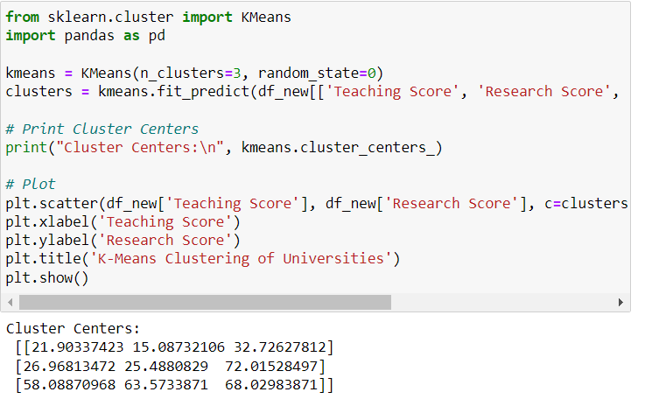
How do universities group based on teaching, research, and international outlook scores, and what insights do these clusters reveal about shared characteristics?
K- Means Cluster Analysis
Conclusion:
The K-means clustering effectively identified groups of universities based on the scores. The result reveal significant differences in the performance and focus areas of these institutions.
Application:
We utilized K-Means Clustering to identify groups of universities with similar characteristics based on selected features such as 'Teaching Score', 'Research Score', and 'International Outlook Score'.
10

Slide 11
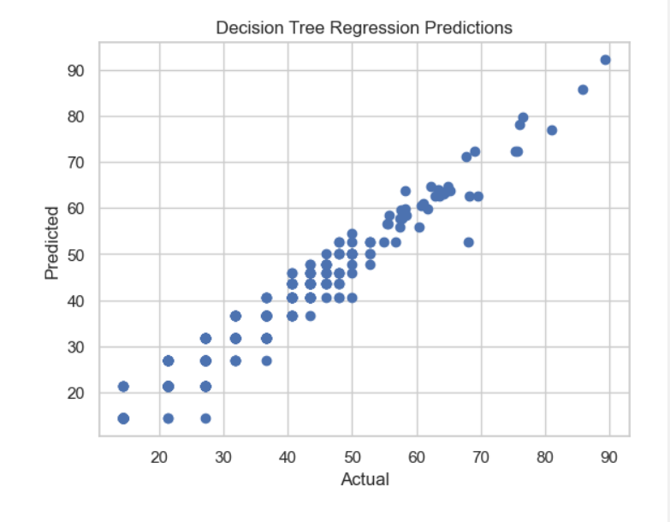
How does the exploration of complex, non-linear relationships and interactions among influencing factors contribute to understanding university rankings? Decision Tree Regression
Methodology:
Brief Description: Decision Trees are a non-linear model used for regression and classification tasks. They split the data into subsets based on the value of input features, which are chosen through a process that aims to maximize the reduction of variance (for regression trees) within each split.
11

Slide 12
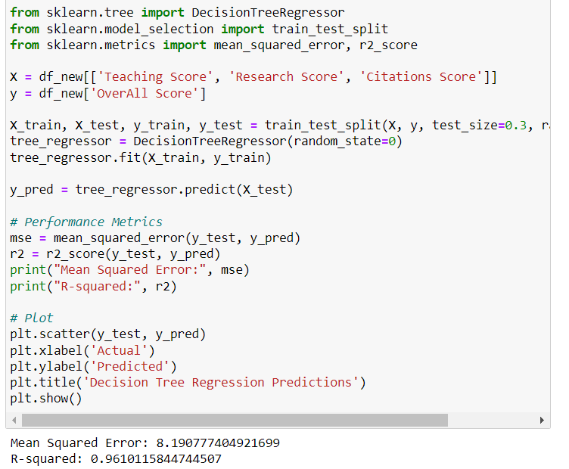
How does the exploration of complex, non-linear relationships and interactions among influencing factors contribute to understanding university rankings? Decision Tree Regression
Conclusion:
The decision tree regressor had a high level of accuracy in predicting the overall scores with the MSE of 8.19 and R-Squared of 0.96. The model is effective in capturing the relationship between these factors and the overall university rankings.
Application:
The Decision Tree Regressor was applied to capture the complex and potentially non-linear relationships between features like 'Teaching Score', 'Research Score', 'Citations Score', and university rankings, allowing us to identify interaction effects and non-linear patterns that linear models may miss.
12

Slide 13
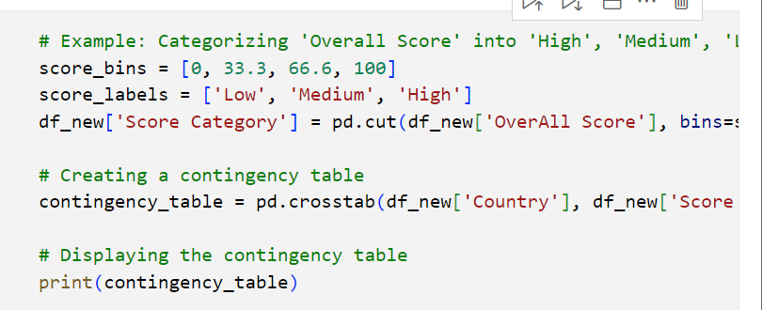
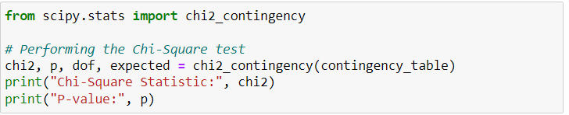
Is there a significant association between university ranking categorical variables and university types? Chi-Squared Test
Methodology:
For our Chi-Squared Test, we chose two pivotal variables from our data: the geographical location of universities (represented by 'Country') and their ranking categories ( high, medium, low tiers).
13

Slide 14

Is there a significant association between university ranking categorical variables and university types? Chi-Squared Test
Conclusion:
This test revealed an association between university rankings and types. The test yielded a p value of 2.31e-80, which is significantly lower than the normal significance level of 0.05. This suggests that the university rankings are not independent of university types.
Application:
The Chi-Squared Test was applied to see if the distribution of different university types across different ranking tiers (high, medium and low) were due to randomness or if there was a deeper systemic relationship associated with it.
14

Slide 15

What are the key factors contributing significantly to the variability in University rankings? ANOVA
Methodologies:
In this analysis, universities were categorized according to the GDP of their respective countries as of the year 2023. This approach is based on the hypothesis that a country’s economic status, indicated by its GDP, could have a significant impact on the rankings of its universities.
What we did is we extracted the 'Overall Scores' of universities which allowed us to make sure that the results reflected the GDP and the impact on the university rankings..

Slide 16
What are the key factors contributing significantly to the variability in University rankings? ANOVA
Conclusion:
The ANOVA test revealed that the differences in 'Overall Scores' across universities from different GDP categories were significant. This finding implied that a country's economic condition is a major factor that contributes to the variability in university rankings, confirming the hypothesis that external economic factors are aligned with university rankings
Application:
In our study, we implemented ANOVA to examine the influence of economic factors, specifically Gross Domestic Product on the rankings of universities. The purpose of ANOVA was to answer the following research question: "What are the key factors contributing significantly to the variability in University rankings?" By grouping universities based on the GDP categories of their respective countries for the year 2023, ANOVA allowed us to compare the mean 'Overall Scores' between these groups.

Slide 17
Limitations
High R-squared values, especially in regression, suggested overfitting, particularly when the model was too complex.
When we performed K-Means clustering, it oversimplified the characteristics for universities.
In PCA analysis, the interpretation of results could not cover the complete complexity of the variables.
The dataset was very sensitive to features/variables when we found out the accuracy of our trained data in decision tree analysis.
Grouping universities based on K-Means clustering scores oversimplifies variation within each cluster, potentially neglecting the distinctive characteristics of particular colleges.

Slide 18
Future work
Have a diversifying range of predictive models to include more machine learning techniques, such as random forests or support vector machines, which would provide a broader understanding of the data.
Employing ensemble methods as they could be explored to improve prediction accuracy.
Explore datasets to get context for geographical or cultural settings and perform subgroup analysis to get more insights on the rankings based on region of universities.
Consider some additional predictor variables as the education industry is constantly evolving in its nature to keep our research more reasonable

Slide 19
Final Thoughts
RESEARCH QUESTION | METHOD | OUTCOME
To what extent do teaching, research, and citation scores contribute to predicting and understanding the university's overall Score' in rankings? | Linear Regression Analysis | Low MSE for the model suggests a high level of accuracy in capturing the relationship between the variables and the overall university score
How do universities group based on teaching, research, and international outlook scores, and what insights do these clusters reveal about shared characteristics? | K- Means Cluster Analysis | The three clusters, characterized by different mean scores across teaching, research, and international outlook, potentially represent tiers of universities with varying academic profiles
What are the key factors contributing significantly to the variability in University rankings? | Principal Component Analysis | Variability in university rankings can be attributed to academic excellence and global presence/ reputation
How does the exploration of complex, non-linear relationships and interactions among influencing factors contribute to understanding university rankings? | Decision Tree Regressor | Universities with a certain level of research score significantly improve their ranking if coupled with high teaching scores, indicating a synergistic effect
Is there a significant association between university ranking categorical variables and university types? | Chi-Squared Test ANOVA | There’s a strong relationship between categorical variables, such as university ranking categories and university types ( public or private)

Slide 20
Conclusion
The diverse methodologies provided a comprehensive understanding of university rankings. They reveal the impact of academic scores, strategic profiles through clustering, key factors driving differences via PCA, and complex interactions with decision tree regression. Statistical tests confirm the influence of categorical factors. This approach is valuable for education stakeholders, aiding informed decision-making.
20

Slide 21
References
Benito, M., Gil, P., & Romera, R. (2019, September 9). Funding, is it key for standing out in the university rankings? - scientometrics. SpringerLink. https://link.springer.com/article/10.1007/s11192-019-03202-z
Mikryukov, A., &amp; Mazurov, M. (1970, January 1). The task of improving the University Ranking based on the Statistical Analysis Methods. SpringerLink. https://link.springer.com/chapter/10.1007/978-3-030-67133-4_6
Sharif, F. S. (2015, July 1). Characteristics of highly ranked universities in the Times Higher Education (the) World University Rankings. VTechWorks Home. https://vtechworks.lib.vt.edu/handle/10919/79640
21

Slide 22
THANK YOU!

